Slide 1

MyRealProduct
Week 2 - Market Validation

Slide 2
Week 2 Submission:
House color: Yellow
Team number: 3
Team lead Email: kkc.palvadi@gmail.com
Other teammates (emails):
Amrutha Amara - amaraamrutha9@gmail.com
Lakshmi Narayana Kanamarlapudi - klnarayana1726@gmail.com
Sai Keerthi Vadnala - saikeerthiv2000@gmail.com
Ganesh Atmakuri – atmakuriganesh1234@gmail.com

Slide 3
Step 1: Common answers from customer interviews
Q1: What challenges do you face when managing your Gmail inbox?
Ans: Customers generally don't face major challenges, but managing a high volume of emails after a few days can be difficult.
Q2: How do you identify and prioritize important emails?
Ans: Customers usually skim through email subject lines to identify and prioritize important messages.
Q3: What would help you quickly understand an email’s sentiment?
Ans: Most customers look at the subject line and sender's name to gauge sentiment, though sometimes they need to read the content for clarity.
Q4: Would a tool that categorizes emails by sentiment be useful to you? Why or why not?
Ans: Customers believe such a tool would be about 75% useful, especially for handling large volumes of emails, though its effectiveness might vary.
Q5: What concerns do you have about using a sentiment analysis tool in your inbox?
Ans: Customers are concerned about potentially misclassifying spam or scam emails as positive. They also worry about whether the tool stores and uses the content of their emails for classification.
Q6: Do you use other tools or extensions to manage your emails?
Ans: Most customers generally do not use other tools or extensions for email management.

Slide 4
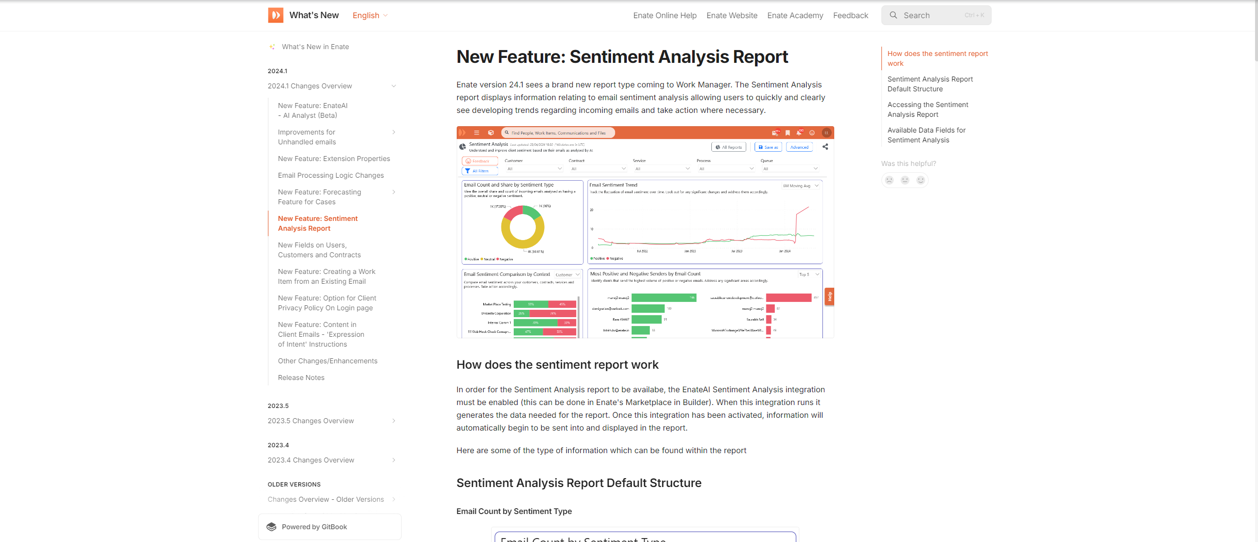
Step 2: Google trends & Online forum analysis

Slide 5
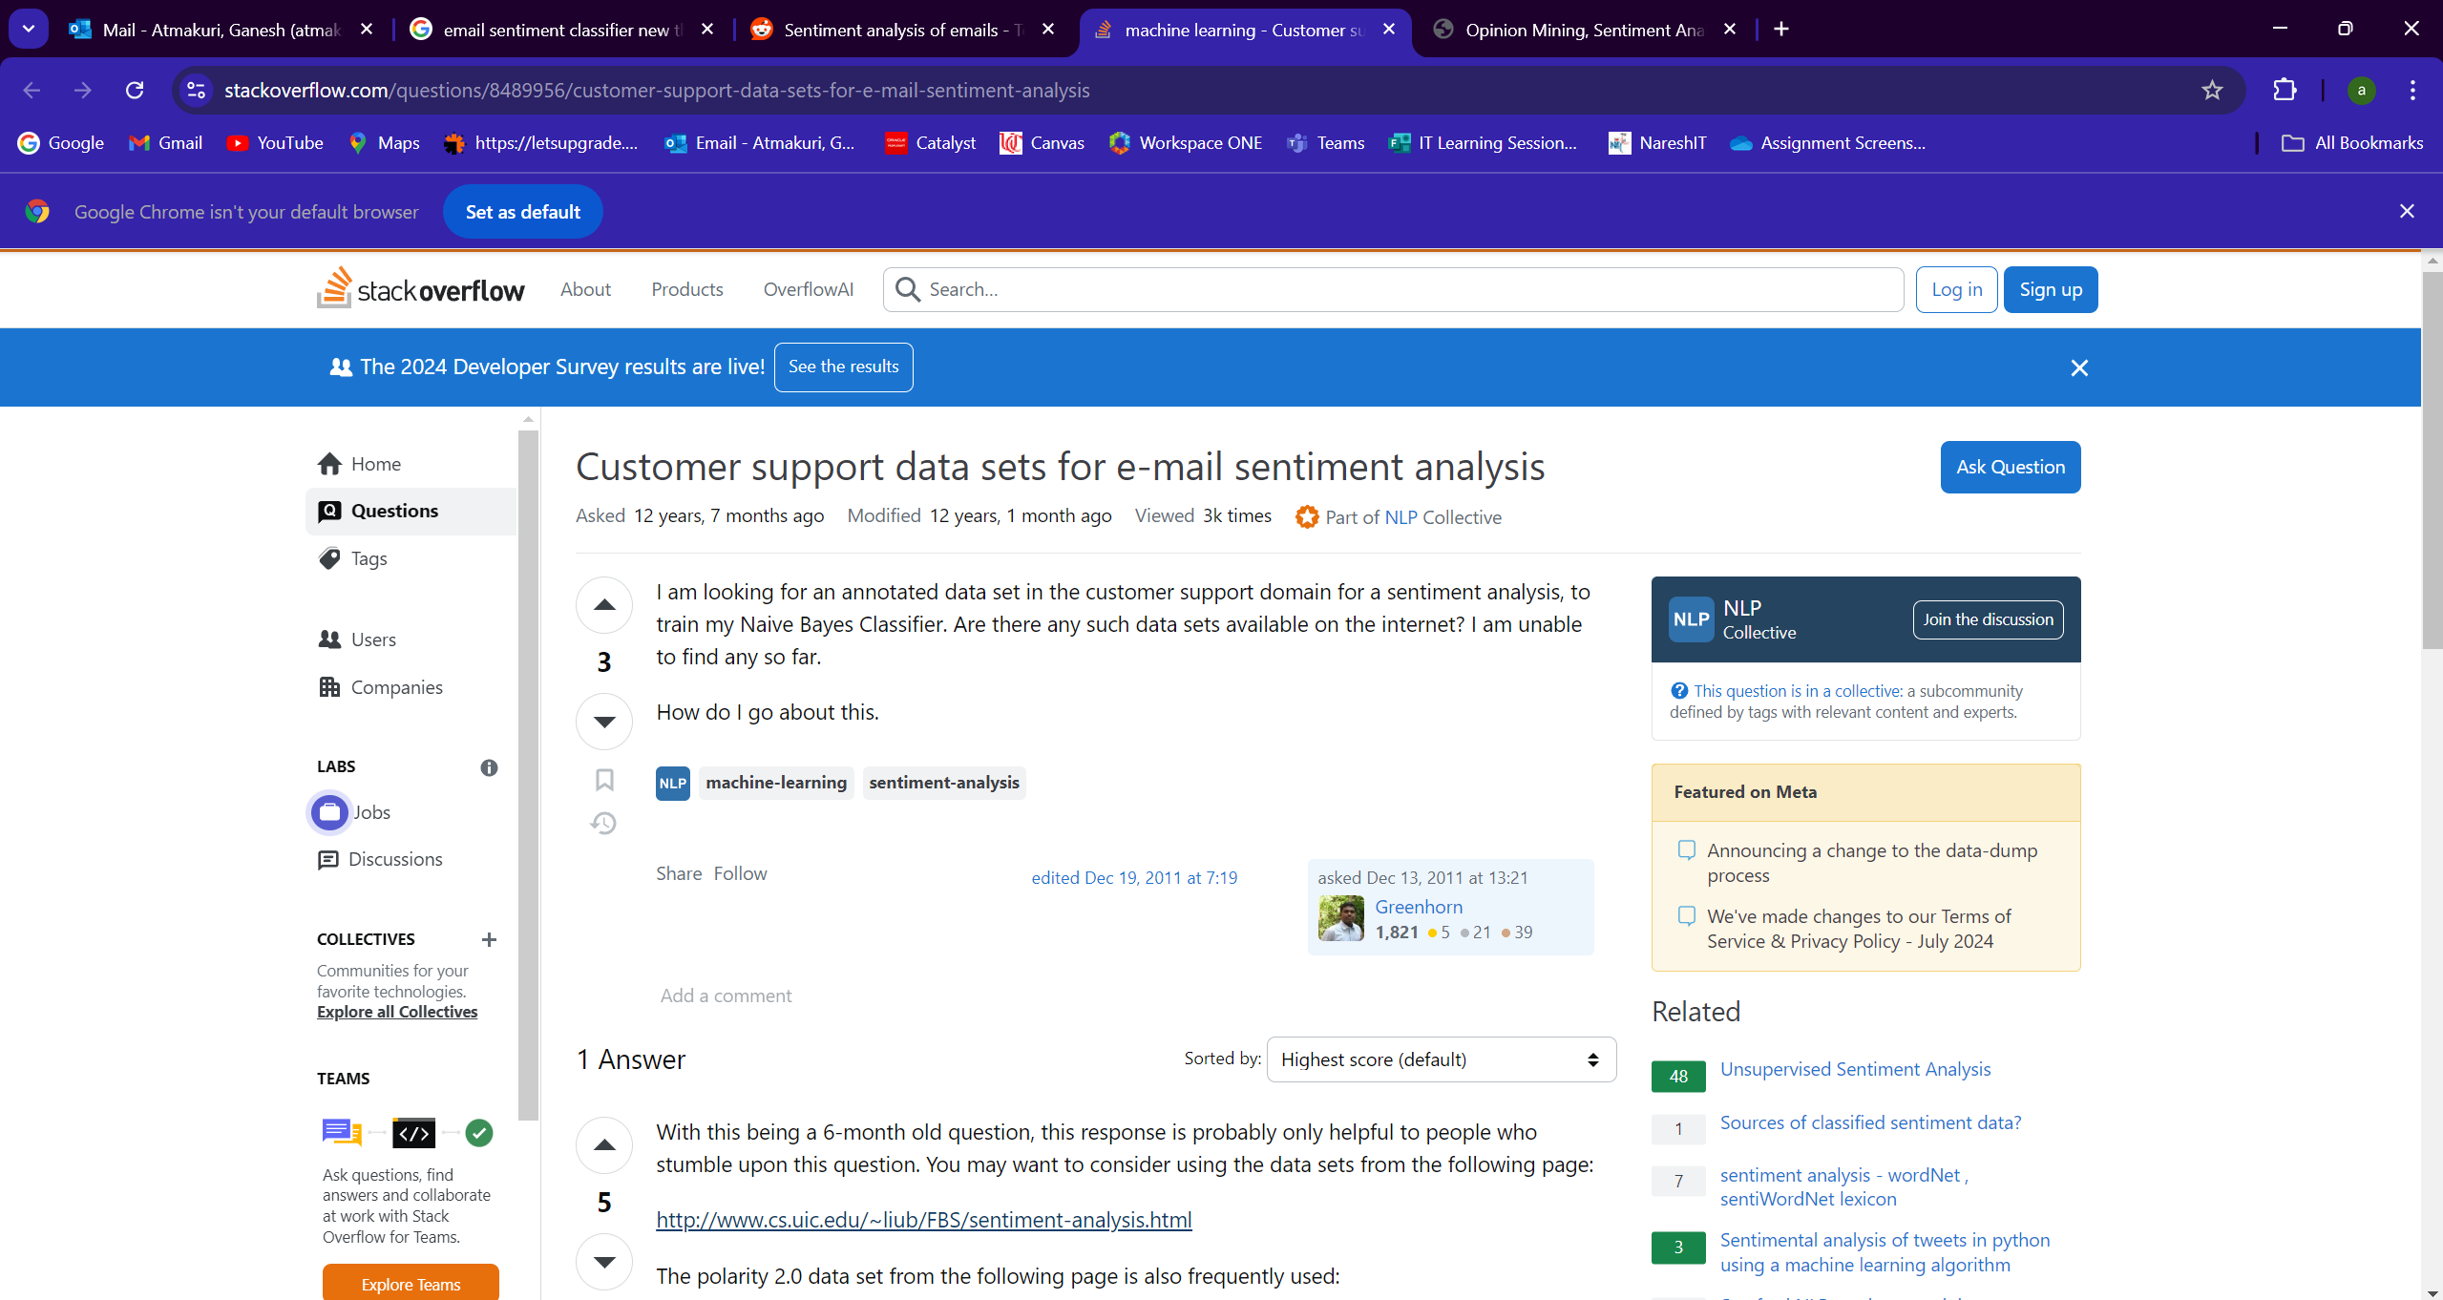

Slide 6
Step 3: Create a Landing Page & Build a Waitlist
Link to the landing page: https://mrp.unicornplatform.page/email-sentiment-classifier/
Methods used to Market the landing page: Used social media platforms such as Instagram, Facebook, LinkedIn, and WhatsApp
Number of waitlists?: 54

